Slide 1


Analysis of Mixer Grinder on
By: Aishwarya.Anantha

Slide 2
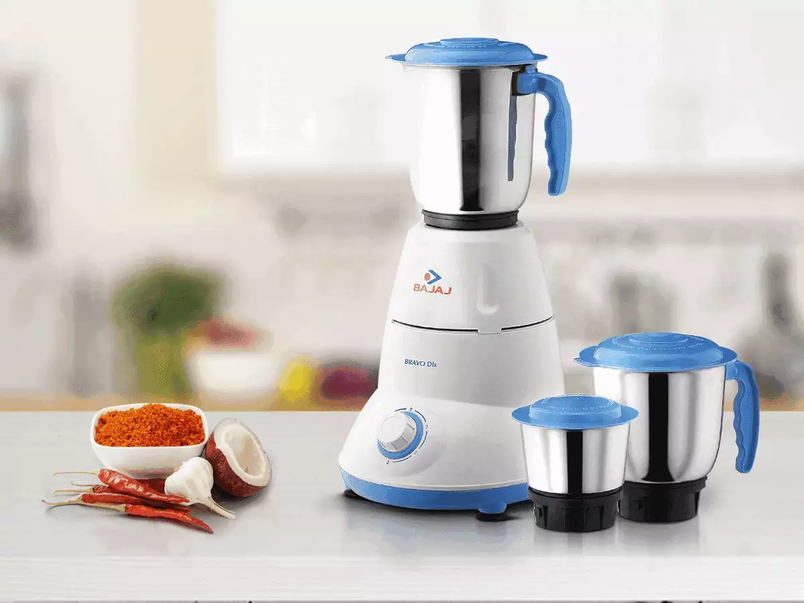

Agenda
- Introduction
- Objectives
- Data Collection
- Univariate Analysis
- Bivariate Analysis
- Insights & Conclusion

Slide 3

Introduction:
Mixer grinders are one of the most essential kitchen appliances, with a vast range of brands and models available on Flipkart.
With increasing online purchases, understanding pricing, brand popularity, customer ratings, and wattage can help buyers and businesses make informed decisions.
Data Source:
The data has been web scraped from Flipkart using Python library BeautifulSoup.

Slide 4
Objectives:
✅Identify the top brands in the market.
✅ Explore the pricing trends of mixer grinders.
✅ Analyze customer ratings and reviews to determine user preferences.
✅ Study the relationship between Brand and Power.
✅ Analyze the graphs and trneds between Rating and Power.

Slide 5
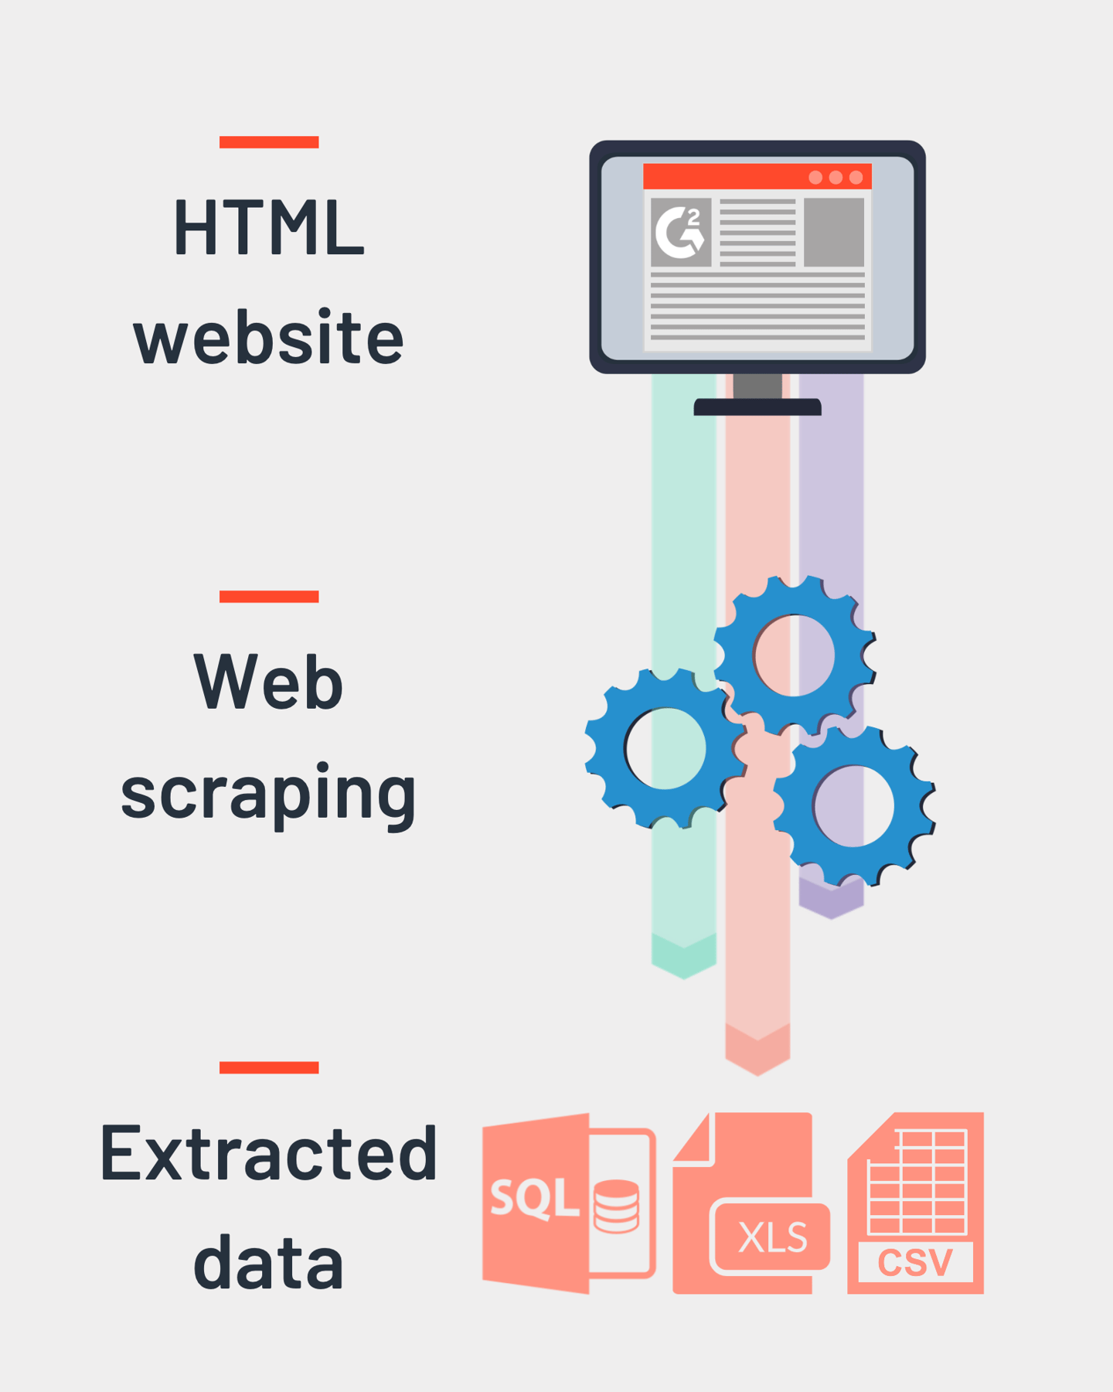
Data Collection:
We extracted essential details such as:
✅ Product Name – Brand name ✅ Price – Current selling price in ₹ and original selling price in ₹ ✅ Ratings & Reviews – Customer ratings and feedbacks ✅ Power (Wattage) – Determines performance efficiency
Web Scraping Approach:
1️⃣ Sent HTTP request to Flipkart’s Mixer Grinder listings using requests. 2️⃣ Parsed the webpage using BeautifulSoup to extract relevant HTML tags.
3️⃣ Extracted product details from <div> and <span> elements.
4️⃣ Stored the data in a structured Pandas DataFrame for analysis.

Slide 6
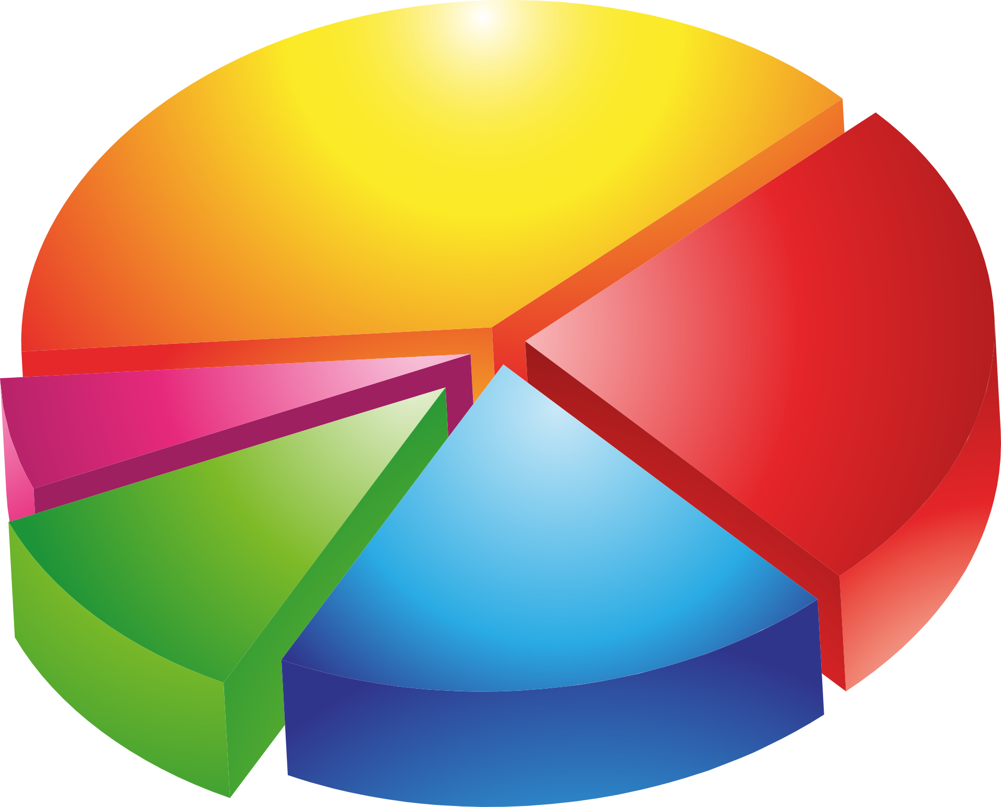
Univariate Analysis:
✅ Univariate analysis helps summarize and explore a single variable
✅ Useful for understanding data distribution and detecting outliers
✅ Different data types require different visualizations
Data Visualization:
Histogram: Showed frequency distribution of numerical data like wattage, price.
KDE Plot: Displayed probability density
Box Plot: Identified outliers and data spread, for prices, original prices, ratings etc.
Categorical Data Analysis:
Bar Plots: Visualized the frequency of categories like Brands distribution.

Slide 7
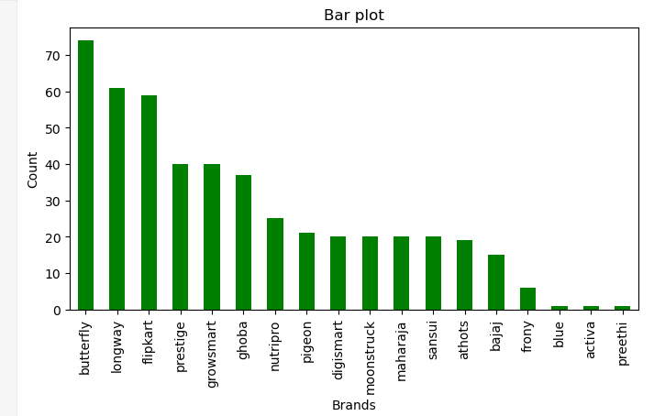
Brand distribution:
Graph shows the top 5 most available brands in market to be Butterfly, Longway, Flipkart, Prestige, Growsmart, accordingly.

Slide 8
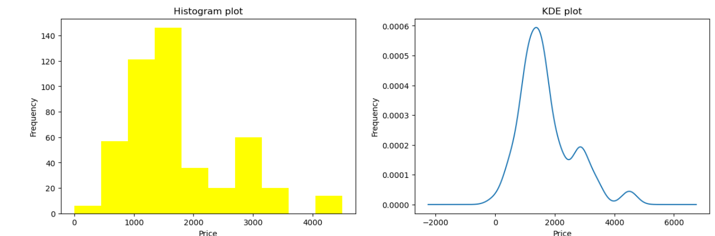
Price distribution:
Both graphs show that price range for maximum number of mixers is from 1000 to 1500.

Slide 9
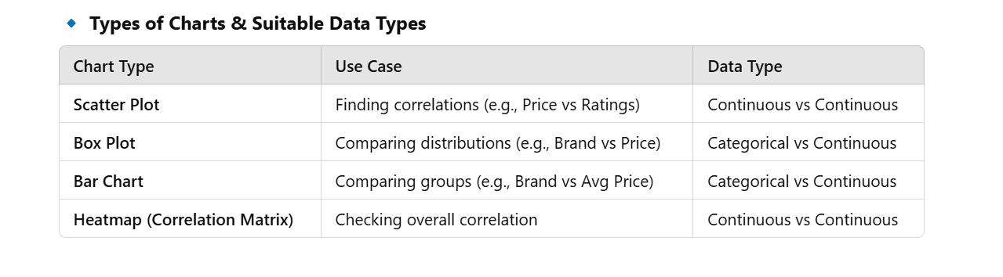
bivariate Analysis:
Bivariate analysis is the statistical analysis of two variables to identify relationships, trends, and correlations between them.
It helps in understanding how one variable affects another.
Data Visualization:
Histogram: Showed frequency distribution of numerical data like wattage, price.
KDE Plot: Displayed probability density
Box Plot: Identified outliers and data spread, for prices, original prices, ratings etc.
Categorical Data Analysis:
Bar Plots: Visualized the frequency of categories like Brands distribution.

Slide 10
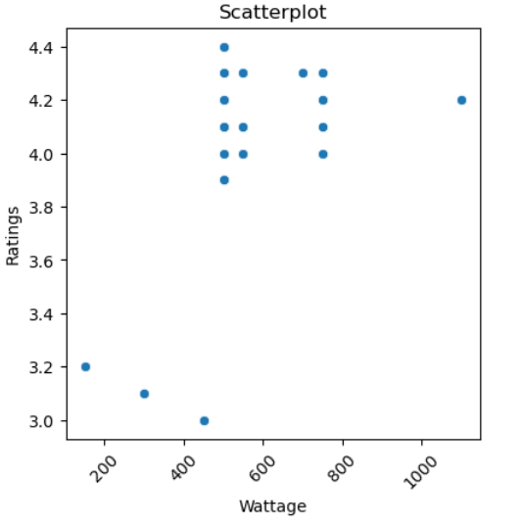
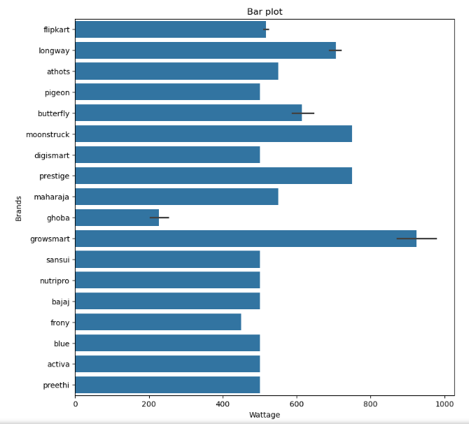
Brand selection based on wattage:
Its good to choose brands with wattage from 500 to 800, according to the ratings for wattage.
Naming a few: Butterfly , Longway, Flipkart.

Slide 11
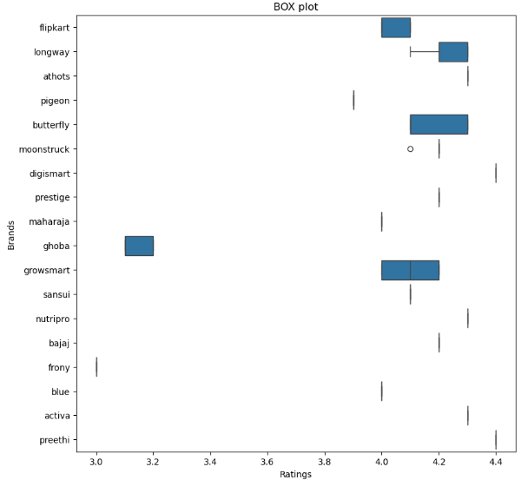
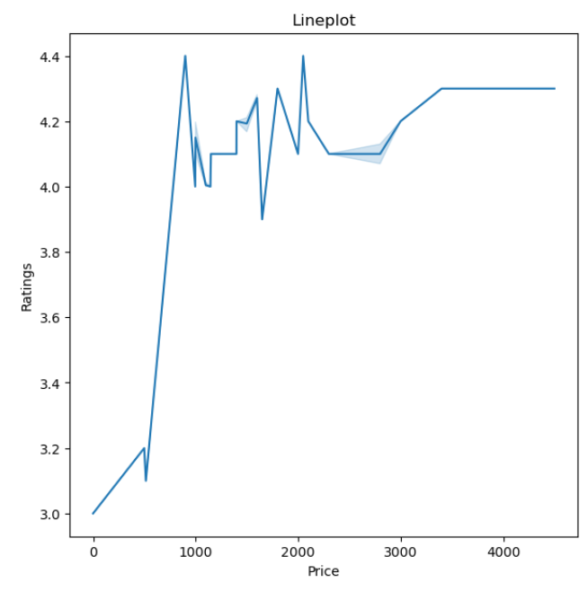
Brand selection based on price and Ratings:
Brands that have good rating of above 4.0 and considering the wattage and price range from 800 - 4000 we can shortlist the final brands.

Slide 12
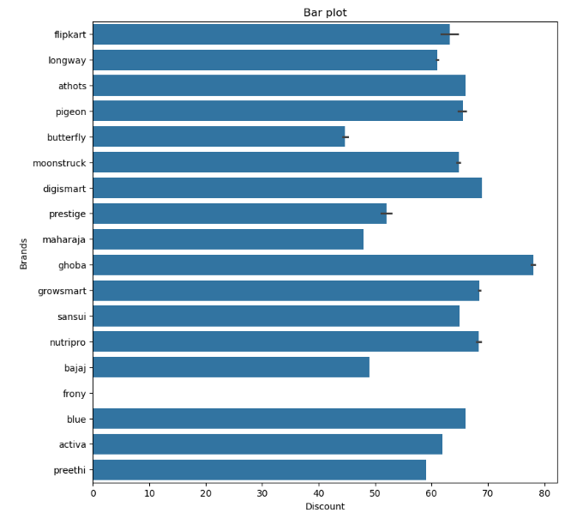
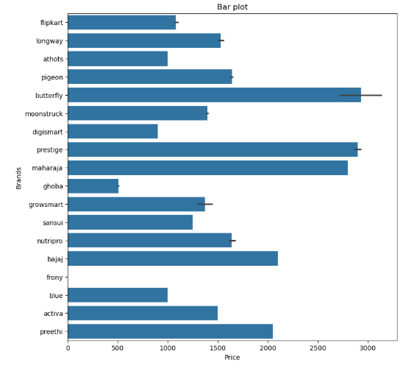
Which brands are providing more discount?
Brand : Ghoda is giving highest discounts, great! It also has lowest price, great! But ratings , wattage?

Slide 13
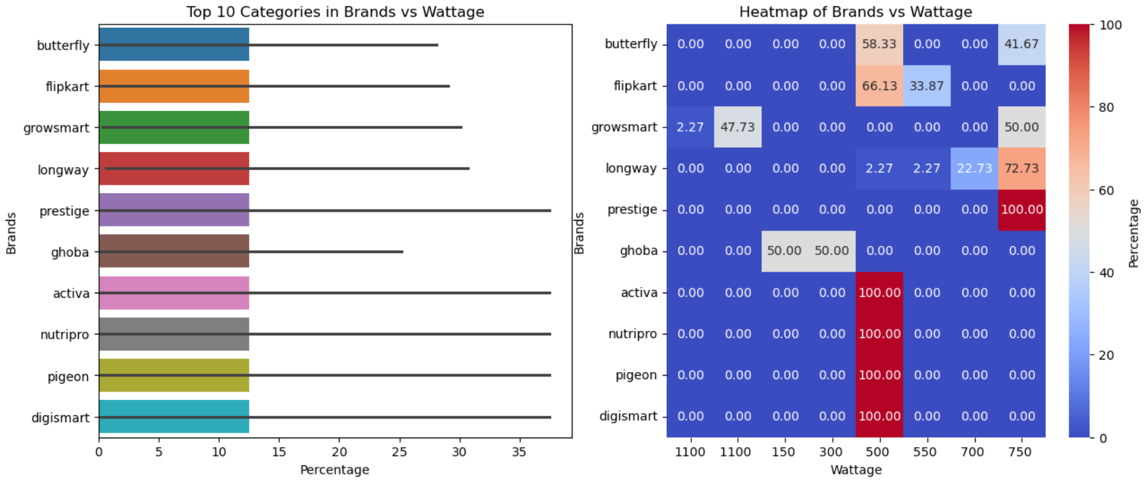
Heatmap: Brand v/s power

Slide 14
conclusion:
Don’t fall for brand that gives greater discount than others, like Ghoda, check out the ratings and wattage respective to the brand, then it doesn’t fit the requirement.
Brands with good rating are : Preethi , Butterfly, Digismart.
Buy mixers in the price range of 800 to 2200, according to the ratings.
Brands with wattage 800W id Growsmart, 750 W are Moonstruck, Prestige, 500W are Pegion, Sansui, etc.
The maximum count of mixers present in dataset are in the ascending order of Butterfly, Longway, Flipkart, Prestige, Growsmart.

Slide 15
References:
https://in.images.search.yahoo.com/search/images;_ylt=Awr1RbT_IMBnfAIAeZS7HAx.;_ylu=Y29sbwNzZzMEcG9zAzEEdnRpZAMEc2VjA3BpdnM-?p=mixer+grinder&fr2=piv-web&type=E210IN885G0&fr=mcafee#id=37&iurl=https%3A%2F%2Fwww.businessinsider.in%2Fphoto%2F77776473%2FBest-mixer-grinders-for-home-in-India.jpg%3Fimgsize%3D173630&action=click
https://www.geeksforgeeks.org/implementing-web-scraping-python-beautiful-soup/
https://chatgpt.com/c/67bab24f-7dac-8004-84ea-cd6cab241457

Slide 16

Thank you!

